Slide 1

Department Of Mechanical Engineering
Project Review-3
“Design and development of light weight ornithopter”
.1NIKHIL S N 1NT15ME097
.2NISCHAY R 1NT15ME100
.3PRAJWAL C 1NT15ME110
.4 BASAVARAJ 1NT15ME024
PROJECT GUIDE:
Dr.SANTOSH KUMAR
(Asst.professor)
PROJECT CO-GUIDE: Mr.Kotgi Kotresh
(Asst.professor)
BB26

Slide 2

Abstract
• The artificial design of the bird was started out with the inspiration of bird flight and breaking that
complex motion into a mechanism that is easily replicable.
• The bird designed is completely mechanical for steady flight and it will also serves video surveillance
features with live feed send to a controlled device on ground through Wi-Fi.
• Thus the design has taken a smart turn to building an UAV that flies like a bird, making it blend in and
undetectable to the naked eye and provide surveillance capability over an area to any number of people
on ground thus providing a new version to the concept eyes in sky.
Department of Mechanical Engineering,NMIT
2

Slide 3
Objectives
• Develop concept sketches into a physical model through a design process.
• To investigate the characteristics of ornithopter UAVs.
• To introduce it in military applications such as aerial reconnaissance without alerting the enemies that
they are under surveillance.
Department of Mechanical Engineering,NMIT
3

Slide 4

LITERATURE SURVEY
S.NO
RESEARCH PAPER TITLE
AUTHOR NAMES
YEAR OF
MAJOR FINDINGS
PUBLICATION
May 7, 2009
• : The ornithopter was designed to be as
lightweight and high performance as possible
so as to maximize payload capacity and are
intended to fail in predicable and ﬁeld
repairable ways.
1.
Design and Construction of an
Autonomous Ornithopter
Zachary John Jackowski
Rajeev Kumar
Bio-Inspired Design of Micro
Ornithopters with Emphasis on
Locust Hindwings
July 3rd 2012
• Two sets of locust hindwings are extracted,
tested and compared with artificial wings. Tests
are performed at zero free stream velocity on
two different transmissions, one strictly
flapping and the other a combination of active
flapping and pitching
2.
3.
Ornithopter with Articulated Wings
Sushobhan Guha
April 2017
• ornithopter which is a highly efficient machine
with low frequency is developed and
numerical analysis of flapping wing was done
Department of Mechanical Engineering,NMIT
4

Slide 5

LITERATURE SURVEY
S.NO
RESEARCH PAPER TITLE
AUTHOR NAMES
YEAR OF
MAJOR FINDINGS
PUBLICATION
4.
Design, Fabrication and Testing of
a Passively Morphing Ornithopter
Wing for Increased Lift and Agility
Dr. David Stargel
12/13/2012
• Passive morphing was achieved through an
optimally designed compliant spine that
mimics the function of a bird’s wrist. compliant
mechanisms proved to be not only feasible, but
also beneficial for application to general air
vehicle design.
5.
6.
Designing a Biomimetic Ornithopter
Capable of Sustained and Controlled
Flight
Joon Hyuk park
2008
2009
• ornithopter under unsteady state flight regime
was developed and believed that an ornithopter
smaller than 10 cm should follow the features
of much smaller insects based on their wings
and flight mechanisms.
. Development of next generation
ornithopter prototypes
John Wood, Daniel Jensen, Peter
Leetsma
• The two primary concepts researched and
prototyped in the completion of this effort were
the disk-rocker mechanism and the Modified
Four-Bar Mechanism. testing of the prototypes
against the specified requirements are shown.
Department of Mechanical Engineering,NMIT
5

Slide 6

LITERATURE SURVEY
S.NO
RESEARCH PAPER TITLE
AUTHOR NAMES
YEAR OF
MAJOR FINDINGS
PUBLICATION
7.
Design , Fabrication and Testing of
flapping wing micro air vehicle
K. P. Preethi Manohari Sai, K.
Bharadwaj, K. Ravi Teja
2013
• The chosen mechanism for turning rotation of
the DCmotors into a flapping movement of the
wings is accurate and leads to error free
functioning. Through more than 300 tests the
wings were optimized in angle and chord
length that yield to enough lift generation for
hover flight
8.
Evolving buildable flapping
ornithopters
Floris van Breugel, Hod Lipson
2010
• In order to create more realistic flapping
patterns that can be achieved with off-the-shelf
servo motors more work will need to be done
to minimize the frequency and velocities.
9.
Innovative flapping umbrella
Yanming wei
2007
2011
• Instead of propeller driven helicopters a
flapping umbrella driven ornithopter that is
powered by pulse power supply.
10.
Development of tabletop test rig
for aerodynamic characterization of
ornithopter.
Divakar anand,Chandrasekhar
•
This proposes a simple and cost efficient
model for real time assessment of lift and
thrust forces and also flapping frequencies.
Department of Mechanical Engineering,NMIT
6

Slide 7
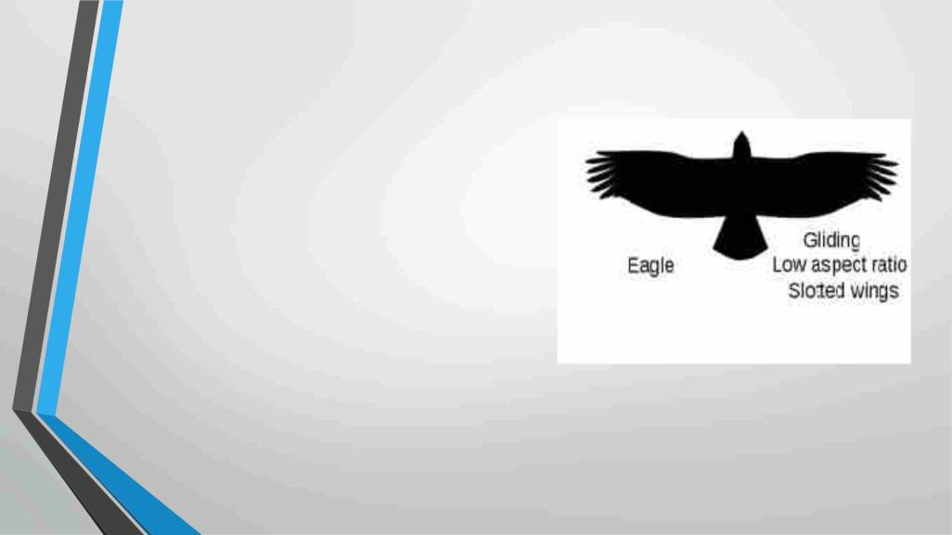
BODY DESCRIPTION
• Body length : 12 inches
• Wing span : 24 inches
• Body weight : 650 - 750 g
• Material used
1. Body
: Carbon fibre
: Polyfoam
2. Wings
Department of Mechanical Engineering,NMIT
7

Slide 8
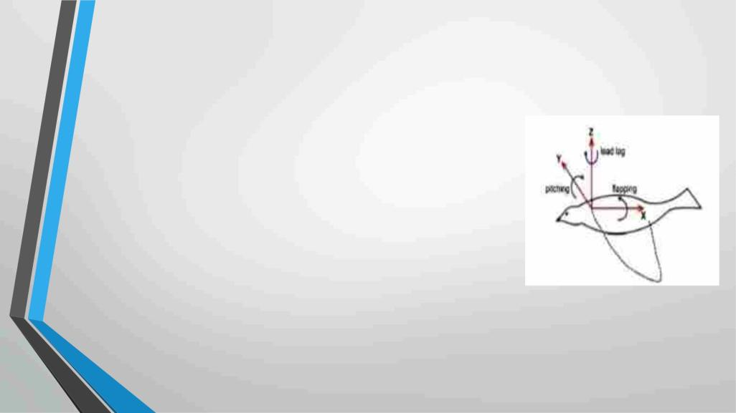
METHODOLOGY
1) KINEMATIC OF WINGS :
• The flapping wing motion ornithopters can have three basic
motion with respect to axis based on the kinematics motion of
wing and mechanism of force generation .
• Flapping , which is up and down plunging motion of the wing .
Flapping produces the majority of the bird's power and has the
largest degree of freedom.
• Feathering is the pitching motion of wing and can vary along the
span.
• Lead-Lag, which is in-plane lateral movement of wing.
Fig: Moments on Wing
Department of Mechanical Engineering,NMIT
8

Slide 9
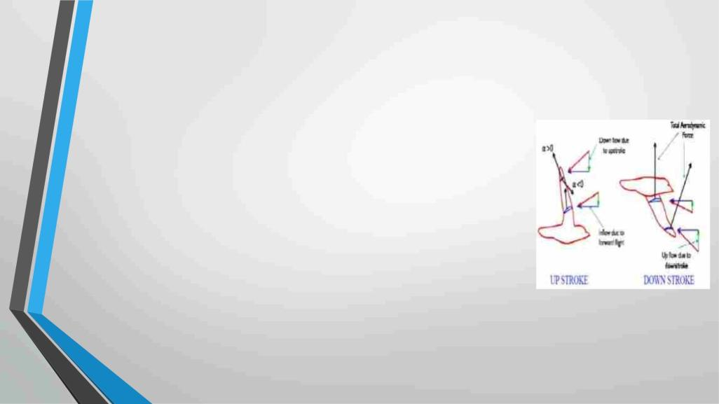
2) Flapping Wing Forces :
UP STROKE :
• Up stoke provide the necessary thrust and the wing is slightly
folded inwards to reduce the energetic cost of flapping with flight.
• Birds change the angle between the up stroke and the down stroke of
their wing.
DOWN STROKE :
• During the down stroke the angle of attack is increased and is
decreased during the up stroke.
• During the down stroke the total aerodynamic force is tilted forward
and has two components, lift and thrust.
Department of Mechanical Engineering,NMIT
9

Slide 10
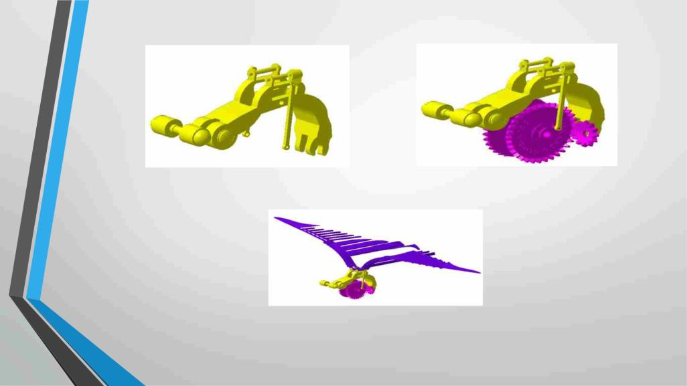
DESIGN MECHANISM
Fig: structure
Fig: Mounting of gears
Fig: Wings
Department of Mechanical Engineering,NMIT
10

Slide 11
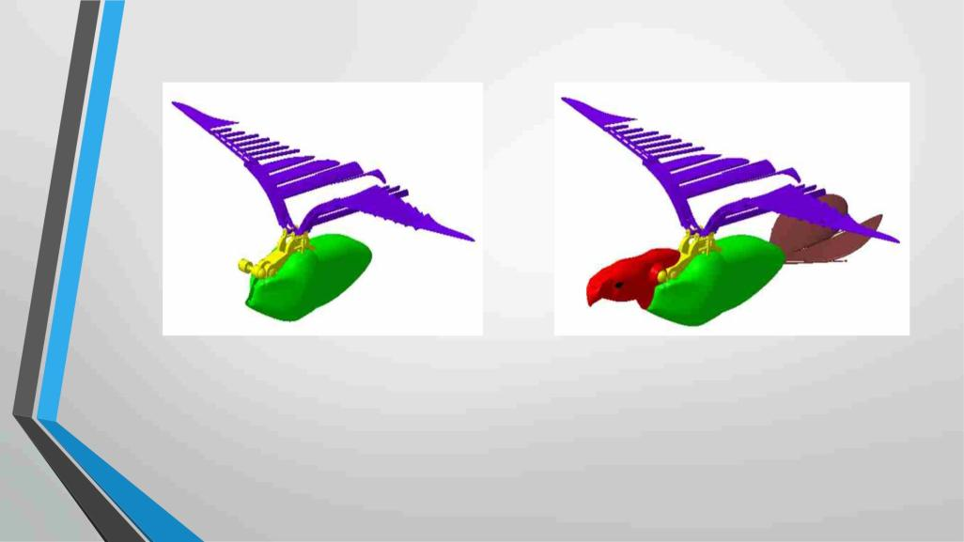
Fig: Body
Fig: Neck and tail part
Department of Mechanical Engineering,NMIT
11

Slide 12
Components used
1. Brushless DC motors:- 4 in no.s /2000 rpm each, out of which two are for wings and two are for head/tail.
2. Bevel gears:- Used as a reduction gear for reducing the speed.
3. Transmitter and receiver :- 2.4 GHz zigbee technology.
4. Motor positioning sensor:- HALL sensor( 3XTLE 4906).
5. Battery: Lithium battery(12V, 2200mA).
6. Micro-controller:-Arduino @M328.
Department of Mechanical Engineering,NMIT
12

Slide 13
Weight calculations
Conclusive weight estimation:-
1. 2* main rib joint: 16.865*2 = 33.72 g
2. Main rib support: 16.865/2 = 8.432 g
3. 3* gear= 24 g
4. 10* main stiffeners= 4*10 = 40 g
5. 8* secondary stiffeners= 3*8 = 24 g
6. Carbon fiber rods = 40 g
7. Battery pack = 99 g
8. 4* micro servo= 2*9 + 2*22= 62 g
9. 1* motor= 60 g
10. Clamps and hinges = 50 g
11. Receiver = 8 g
12. Camera = 32 g
Department of Mechanical Engineering,NMIT
13

Slide 14
Expected Outcome
• Through the use of light-weight materials in the market we are able to create an UAV that exactly
mimics the flight pattern of a bird and fly undetected. The structure of the bird and its behavior makes
it blend in and not easily noticeable to the eye.
• The flight pattern helps in slow flying of the UAV and the onboard camera module helps in high
quality live video capture which is streamed to any device on ground, even to the mobile phone.
Department of Mechanical Engineering,NMIT
14

Slide 15

Ghantt Chart
2018
Aug
Aug
Sep
Sep
Oct
Oct
Nov
Nov
Dec
Dec
Jan-2019
Jan-2019
Feb
Feb
Mar
Mar
2019
Literature
Survey
Experimentation
Report
Writing
Department of Mechanical Engineering,NMIT
15

Slide 16
THANK YOU

